Slide 1

Section 523 Self-Help Housing Application Training
Prepared by the T&MA Contractors
2/1/23

Slide 2


Throughout this slide presentation, the recommended “best practices” will be notated with a ^{*BP}.

Slide 3
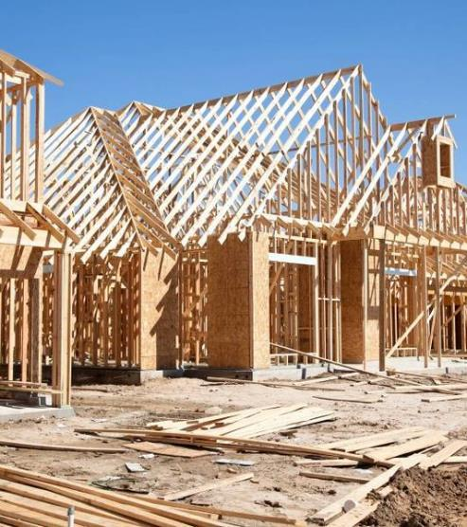

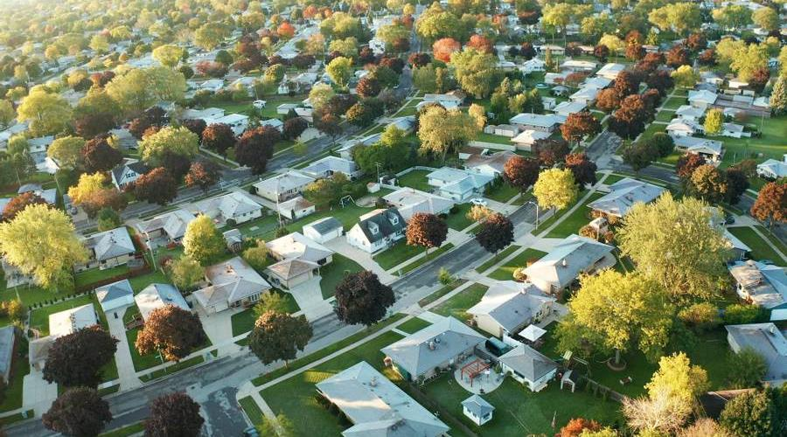
Introduction – What Now?
Should take 3 to 4 months
A working relationship with Rural Development is critical
Your T&MA (Technical and Management Assistance) Contractor is available throughout the process
^{*BP} Use your T&MA Contractor as a resource ANYTIME assistance is needed!

Slide 4

New organizations must pay for:
The cost of developing the application (staff time, house plans, marketing, securing land, etc.)
Feasibility study
Program and organizational development
This can be costly…be prepared!
*BP – Seek other funds or raise funds from other sources

Slide 5
Rural Development
National Office
Develops program policies
Interacts with Congress
Reviews grant applications for more than $300,000
State Office
Disburses 502 funds based on a state formula
Reviews smaller grant applications ($300,000 or less)
May be responsible for the 523 grant
Area Office
Responsible for the 523 grant
Local Office
Makes and monitors the 502 loans
Co-signer for checking accounts
Construction inspections

Slide 6
RD provides administrative and loan funds
Expects grantees to carry out grant agreement
^{*BP} A grantee’s working relationship with RD is critical to the success of the program

Slide 7
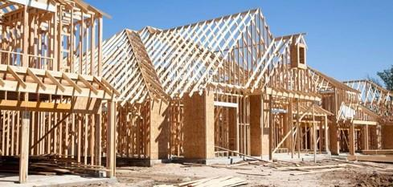


RD’s Expectations from Grantees
Operate within RD’s regulations
Carry out the responsibilities of the Grant Agreement including:
  Recruiting low and very-low income applicants
  Building the number of homes proposed
  Building the houses in a timely manner
  Keeping program costs within the guidelines and budget
  Setting up an acceptable accounting system and adequately tracking the expenses

Slide 8

Feasibility

Slide 9
Feasibility
^{*BP} Even experienced grantees cannot bypass feasibility
The old way is not always the best way
Organizations must continually monitor:
          Need
          Affordability
          Land availability and cost
          Availability of potential participants
          Staffing patterns
^{*BP} See Feasibility Handbook

Slide 10
Application Format

Slide 11
Required Format
The format of the application is very important
Rural Development requires that the information be in a specific order
Applications are encouraged to be submitted electronically
Tabbed PDFs are best
Sections must correspond with item numbers on RD checklist

Slide 12

^{*BP} An organization can drastically reduce its chances of error by having someone that did not put the application together recheck it for completion and accuracy before sending it to your T&MA Contractor or RD.

Slide 13
Application Processing Checklist
RD has a grant checklist
Exhibit G is for both New Construction and Rehab
This new checklist came out on 3/28/22 as PN 561

Slide 14

T&MA Application Checklist
Checklist the Contractors use to review applications
It has more detail and will help meet all requirements
See Application Handbook, Appendix 1 & 2

Slide 15
1. Standard Form 424A
Standard Form 424, “Application for Federal Assistance” and Intergovernmental Review Response 1994.410(e)
        First thing that reviewers see, sample in Handbook
        Provides RD with all of the pertinent information about the project – how many homes, time period, area, funding, etc.
        Must be complete and signed

Slide 16
^{*BP} There are many outdated or incorrect forms out there. Use the correct form!
Best place to get correct forms…eForms
Contact your T&MA Provider or RD if help is needed

Slide 17
2. Waiting List of Participants
Waiting list should include:
Information on potential applicants interested in participating in the self-help program
        Names, addresses, number of persons in the household and total annual income is required
        Date of initial contact not required but helpful for marketing & recruitment (Sample in Handbook)
        Also track demographic information to help RD with its compliance review and civil rights impact survey
  ^{*BP} Aim to have at least three times as many potential participants as would be needed to complete the grant
Application Training

Slide 18
3. Proof of Qualified Participants
Proof is required that participants in the first group have qualified for assistance or been determined “eligible” by RD
Proof will be Certificate of Eligibility (COE) letters from RD
Many grantees request that this be a condition of grant closing
        The grant cannot close until proof of the first group is provided
For rehab, 10% of participants should be qualified
Application Training

Slide 19
What Has to Happen for COE letters to be issued:
  Full application must be processed and reviewed (Sent by eForms including required 3-A Disclosure Letters)
  Household income is verified
  Credit history is checked
  All other eligibility requirements met
  Loan Originator determines payment subsidy and
  maximum loan amount
  Letter of eligibility is issued - (3550 HB letter 16 – special COE for SH)

Slide 20
^{*BP} Include a cover page to this section. This narrative should include:
Number of participants in the first group
List of participant names
Total cost estimates
Total 502 loan amount
Other loan/grant information that will be used for the participant

Slide 21
If RD’s 502 loan does not cover complete building costs, include narrative indicating how the gap will be covered
If there are additional loans, advise RD’s local office:
  Additional debt may result in increased debt to income ratios
Proof will be needed that these funds have been secured

Slide 22
4. Lot Options for First Group
Land for the first group must be in control
  Purchase agreements
  Copy of deed if owned
  Option agreements
Include a narrative identifying number in first group, how land is controlled, by whom, when it will be purchased and where it is located
Consider CCRs (covenants, conditions & restrictions) when looking for land
Application Training

Slide 23
Often grantees need interim financing to obtain land
Control land by purchasing or entering into an option agreement
See sample of Option to Purchase Real Estate in Application Handbook
Caution!! 523 Grant funds CANNOT be used to option or purchase land. RD does have a site loan that can be used for this purpose.

Slide 24
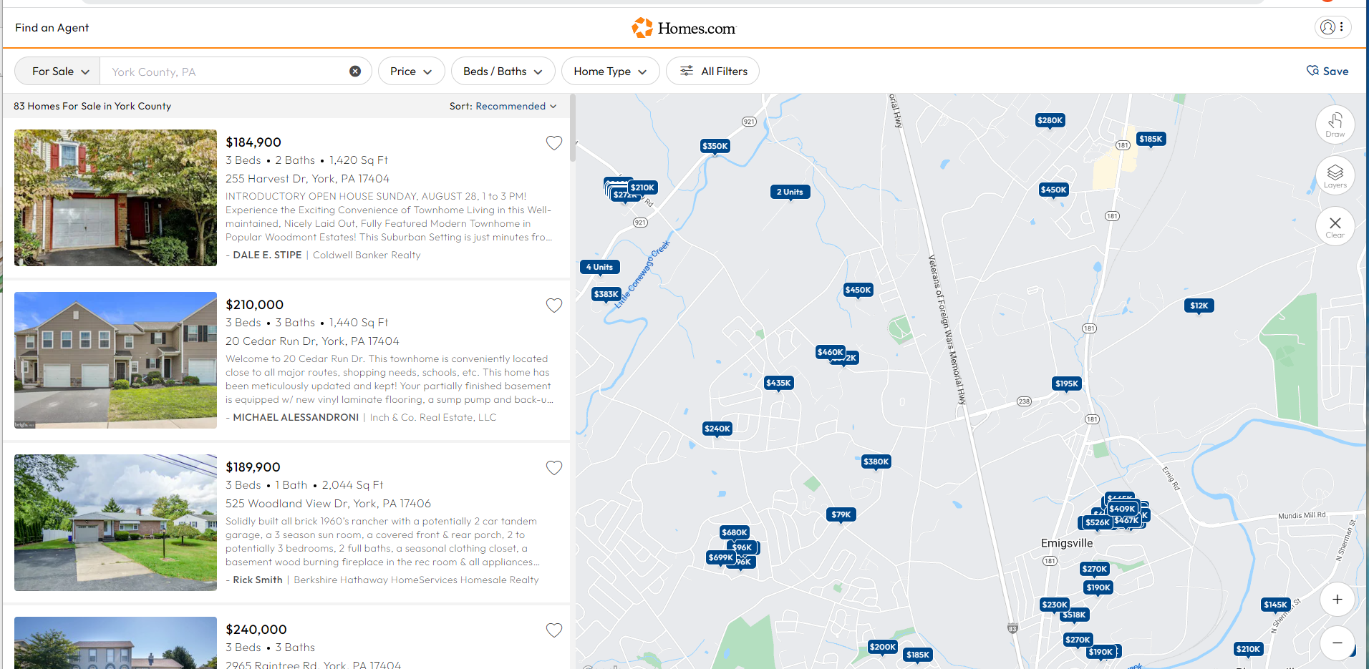
For Rehab Application
List potential homes for sale or owner-occupied homes identified for repair
Use MLS listings or another source

Slide 25
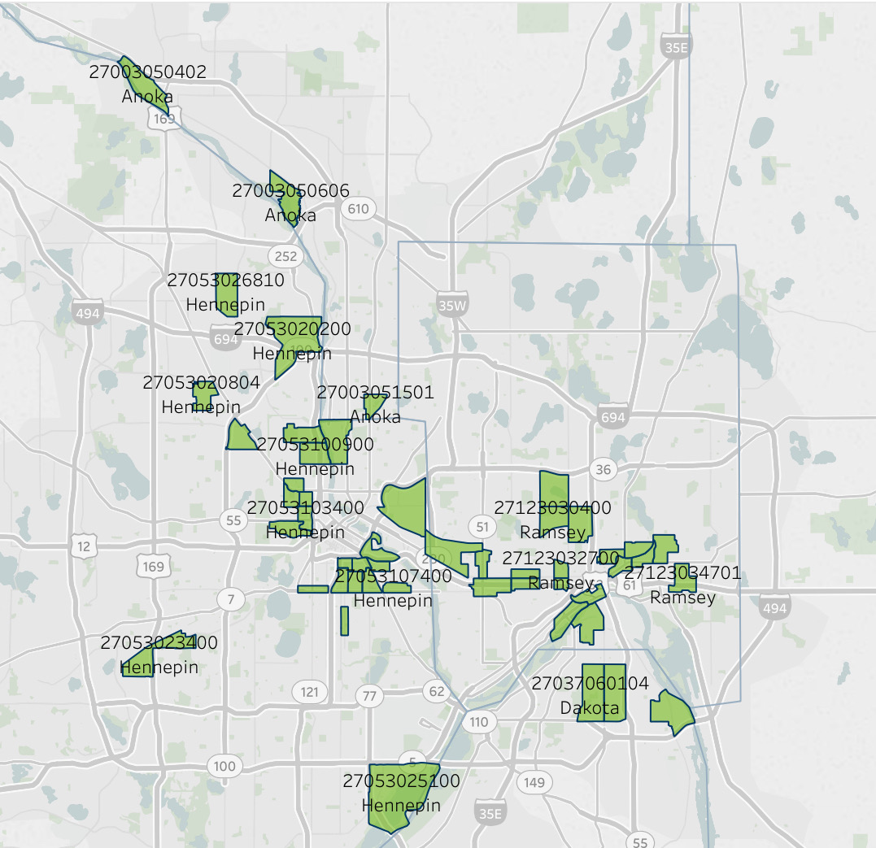
5. Evidence of Lot Availability
Evidence of lot availability for remaining groups is required
Lists of available lots, maps and prices are required
Include a narrative summarizing what land is available, whether site development is required, timeframe for completion
For rehab, include list of potential homes

Slide 26

6. House Plans, Specs, Detailed Cost Estimates
Certified house plans are required for EVERY model that will be built during the grant period
Specifications are required for every model and for every family in the first group
Detailed cost estimates are required

Slide 27

For rehab, describe the process of:
  Obtaining home inspections
  Creating a work order
  Cost estimating
  Scope of work selection
  Subcontractor selection process

Slide 28
House Plans
Certified house plans are required for EVERY model that will be built during the grant period.
  A complete set consists of plans and blueprints which have been certified by an architect or engineer licensed in your state.

Slide 29
Blueprints need to include the following views with mechanicals noted:
Foundation plan
Floor plan
Cross section
Front and rear elevations
Right and left side elevations
Include a statement of the square footage of livable space for each plan

Slide 30
Standardize Plans ^{*BP}
  Limit selections to three basic plans
        Plans can have varying living areas and varying number of rooms
        Cost estimate and use of materials will remain the same
        Construction Supervisor and participants will become familiar with plans
  Try to standardize the cabinet and kitchen arrangement
  House plans should be prepared in advance of the formation of the first group of participants
  Only one set needs to be certified original, the rest can be copies

Slide 31
^{*BP} Choose plans based on what is in demand by surveying the target area and participants’ affordability!!
Application Training
2023
31

Slide 32
Developing Specifications
After selecting house plans, develop a specification sheet
If an architect is providing the plans, ask them for the spec sheet
Use Form RD 1924-2, “Description of Materials”
One spec sheet should be used
for each participant in the first
group or at least for each house plan

Slide 33
The “Description of Materials” Form 1924-2 is required https://forms.sc.egov.usda.gov/efcommon/eFileServices/eForms/RD1924-2.PDF
Each set of plans must also have a plan certification https://forms.sc.egov.usda.gov/efcommon/eFileServices/eForms/RD1924-25.PDF
Contact your T&MA Contractor or RD if you need assistance
Material identification should be detailed
Attach additional sheets if necessary and manufacturer’s specification sheets for equipment and/or special materials

Slide 34
The design must meet RD’s requirements which include:
  Must follow local and state building codes
  At a minimum, the home needs to meet RD’s Thermal Performance Standards (1924-A, Exhibit D)
  RD’s Area Loan Limit
  No smaller than 400 sq ft (exceptions can be made based on tiny home communities)
  No income producing facilities

Slide 35
Inspect every spec sheet for accuracy and completeness
If questions arise, the plans and specs submitted will be used by RD
Use the Guide for Inspection of Construction of Dwellings and Buildings
Construction supervisor responsible for completing the specs submitted in each loan application
The State and the RD State Architect must approve the plans and specifications

Slide 36
Cost Estimates
One of an agency’s primary responsibilities is to accurately estimate the cost of each participant’s home before it is built
These cost estimates must be accurate, they eventually become the participant’s 502 mortgage
Avoid estimates that are unrealistically low
Cost estimates can include up to a 5% contingency for unforeseen costs, but try not to underestimate costs

Slide 37
^{*BP} If there is a significant gap between the time of actual construction and when the cost estimates were obtained, update the figures to reflect current market prices.

Slide 38
Construction Materials Cost Estimate
To create a material list (take-off), the Construction Supervisor must:
    Review the drawings of a single house plan
    Record the materials that are called for in the drawings
Once the take-off is completed, you should have a full listing of all materials (quantity and quality) required

Slide 39
After obtaining the material bids, visit the supplier
Meet the salesperson
Discuss delivery format, return policy, service area and inquire about credit accounts for the participants
Look for discounts for bulk purchases or get a guarantee on prices in advance

Slide 40
Subcontractor Bids
After obtaining subcontractor bids:
  Interview the potential subcontractors
  Ask for and check client references
  View their past jobs
  Determine their integrity and timeliness
  Get a copy of their license and insurance coverage – check the expiration date of both
  Provide a list of potential subcontractors to RD for the DNP portal check
Include the participants in this process, they will be signing the contracts
Advise the participants, explain benefits and drawbacks concerning the subcontractors

Slide 41
Prepare a construction contract (sample in handbook) and attach the subcontractor bids
Participants and subcontractors sign the construction contract
Rural Development’s contract is preferred
If construction contracts other than RD’s are to be used, get RD approval

Slide 42
Land and other variable costs
In addition to direct costs, soft costs need to be determined
Soft costs include:
Land
Fees (permits, surveys, closing costs, etc.)
Site improvements (grading, fences, driveways)
Landscaping
Contingency funds (up to 5%)

Slide 43
Preparing House Designs
A General Flow of Events
Research Building Standards
  Determine local building codes
  Determine acceptable RD design
Select House Designs
  ^{*BP} Have the house designs approved by RD as early as possible to ensure they meet RD standards
Get Plans Certified

Slide 44
IV. Estimate Costs for Each House Design
  Prepare material take-offs
  Determine which construction jobs to subcontract
  Issue request for bids, evaluate bids, select suppliers and subcontractors
Involve Individual Families
  Each family selects their lot and house plan

Slide 45
Prepare House Documents for 502 Dockets
(for each household)
    Detailed house plans and specs
    Plot plan
    Water/waste disposal system (if applicable)
    Cost estimate
VII. Send Docket to RD for Approval
Send House Documents to Local Officials
    Obtain building permit
IX. Construction

Slide 46
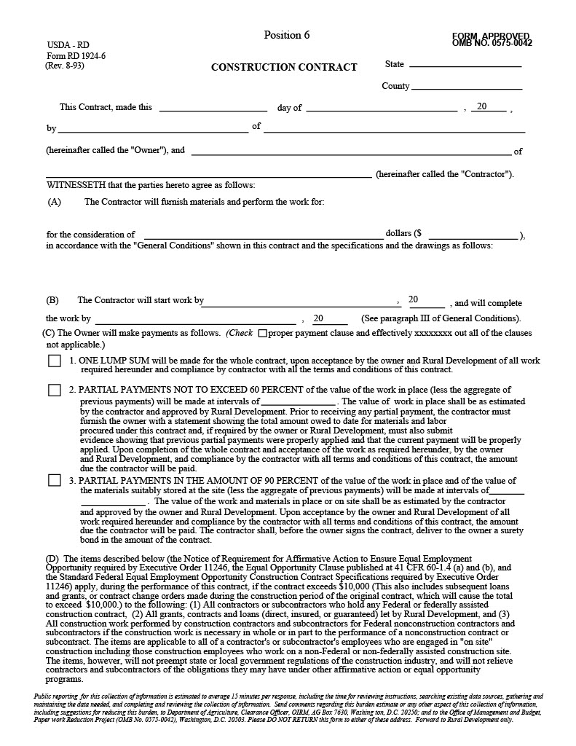
Construction Contract
See Guide for sample of the RD Construction Contract, Form RD 1924-6
Other contracts can be used with approval from RD

Slide 47
Guideline for Purchase of Bidding Supplies/Soliciting Subcontractors
A guideline will need to be established
Organizations may use their own procurement policies and procedures
  They must meet the minimum standards for OMB requirements

Slide 48
See Application Handbook for Samples
  Cost estimate summary
  Construction task matrix
  Self-help family time sheets

Slide 49
7. Staffing Needs and Hiring Schedule
A self-help organization needs:
A good program
A sound budget
A committed Board of Directors
Qualified and motivated staff!
Application Training

Slide 50
Staffing / Personnel
The regulations require:
  Proposed hiring schedule
  Availability of prospective employees
  Job descriptions
  Resumes of employees
  Board’s signed statement that authorizes the Executive Director to hire the necessary staff

Slide 51
Hiring Schedule
A hiring schedule should be included in the application
Include all positions that will be paid out of self-help housing grant funds
^{*BP} See Application Handbook for a sample

Slide 52
Hiring Schedule Should Indicate:
Which positions are filled
The anticipated hiring date of the remaining positions
Which positions will be full-time? Part-time?
What percentage of their time will be charged to the self-help program

Slide 53
Availability of Prospective Employees
To prove the existence of potential candidates, include a resume and letter of commitment from the candidate
If waiting until grant approval, include a description of how needed staff will be located and a brief report on available personnel in the area

Slide 54
Identifying the availability of personnel in the area will require:
  the number of applications received for the job advertised
  a narrative describing the expected hiring process
Rural Development needs to be notified for approval prior to hiring changes occurring

Slide 55
Job Descriptions
Job descriptions for each position paid for with grant funds are required
Samples in Handbook
Typical staff positions:
      Executive / Project Director
      Group Coordinator
      Construction Supervisor
      Secretary / Bookkeeper

Slide 56
Resumes
Resumes are required for each position paid for with grant funds
Make sure they are updated to include their current position

Slide 57
Board Signed Statement
A resolution from the Board is required
It should authorize the Executive Director to hire or employ the necessary staff

Slide 58
8. Authorized Representative of Applicant
Provide the name, address and official position of the applicant’s representative that is authorized to act for the applicant and work with Rural Development
A copy of the authorizing resolution should be included here
Application Training

Slide 59

9. Budget Information – Non-Construction
Requirements:
  424-A
  Detailed Budget
  Detailed Budget
  Narrative

Slide 60
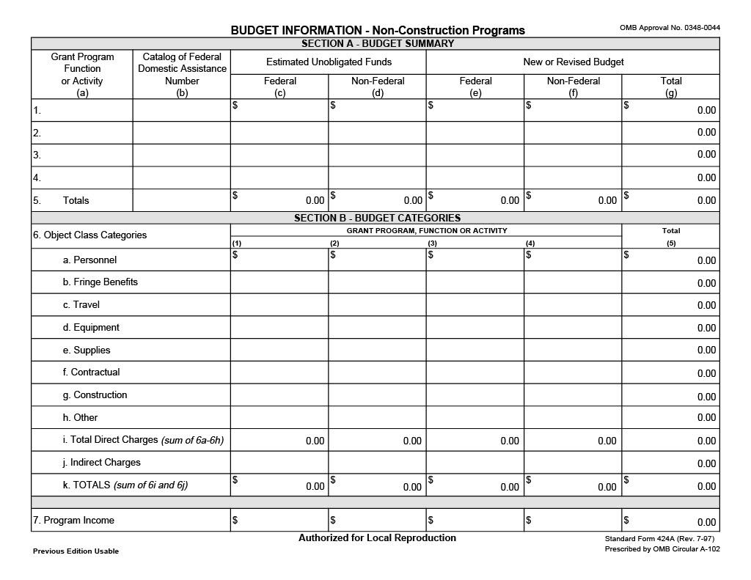
424-A
  Budget must be on form SF-424A, “Budget Information (Non-Construction Programs)
  Complete it using the example in the Application Handbook
  Look online for the most recent version
Application Training

Slide 61
  Detailed budget
  Include a detailed budget
  See sample worksheet in Application Handbook
  Remember to include funds for National Rural Self-Help Housing Association (NRSHHA) dues
Detailed budget narrative
  Include a detailed budget narrative
  See sample in Application Handbook

Slide 62
^{*BP} Do a realistic budget before determining your TA grant amount to see if your budget is truly realistic and falls within RD’s guidelines
The TA Grant amount depends on organization’s experience and capacity
Maximum amount for any grant period will be limited to a certain TA cost per house
Application Training

Slide 63
Authorized expenses:
Personnel salaries
Reasonable office expenses and supplies
Employment benefit costs
Purchase or lease of power tools
Insurance
Reasonable fees for training
Consultant and legal fees
Annual audits
Prohibited use of funds:
Paying for labor on the houses
Purchasing real estate or building materials for the families
Paying any debts, expenses or costs to the participants
Any lobbying activities prohibited in 2CFR 200 Subpart F
Any costs or debts incurred prior to the start date of the grant
Application Training

Slide 64
10. Indirect or Direct Cost
Transmittal Letter
Response
Proposal
Application Training

Slide 65
An approved direct or indirect cost policy must be submitted
  Document the indirect cost rate, if the organization already has one
  If single funded and using direct cost, the budget narrative approved by the Board will be the direct cost policy

Slide 66
  If a new indirect policy is needed:
    Prepare proposal for submission to the Department of the Interior (DOI) for approval and include proposal in application
    DOI will not review proposal until grant is approved
    You could also elect to use the 10% de minimus rate

Slide 67
11. Monthly Activities Schedule
A finalized monthly activity schedule is necessary.
Monthly activities schedules allow for:
  Setting specific goals
  Identifying time targets
  Identifying persons responsible for tasks
  Letting everyone know what he/she is supposed to do and whether or not they are on target
  Identifying potential problems and opportunities
  Improving decision-making process
  Focusing on grant activities to results
Application Training

Slide 68
^{*BP} When planning, estimate a time range instead of a specific date, this keeps your schedule more realistic
The four most significant time elements are:
  Duration of each step
  Earliest time each step may be started
  Latest time each step may be started
  Latest time each step may be completed

Slide 69
It takes everyone’s commitment to implement the self-help project
The activity schedule should not be created and forgotten
Use it to stay on track
Adjust if necessary
See Application Handbook for samples

Slide 70
The included schedule must contain:
  The number of groups
  The number in each group
  Starting and ending dates for recruitment, loan processing and construction
  Must have months indicated

Slide 71
12. Personnel Practices and Procedures
A copy of the most recent personnel policies is required
      Must be in compliance with federal, state and local laws that affect employees
Personnel forms also need to be included in the application and should include:
  Time Sheets
  Travel Advance Requests
  Mileage Forms
  Leave Requests
  Employment application
Application Training

Slide 72
13. Authorizing Resolution
A resolution must be adopted by the Board of Directors (or other governing body):
  Authorizing one or more specified persons to act on organization’s behalf. It must state that they are able to:
    Sign the Grant Agreement, 1944-I, Exhibit A
    Sign Form RD 400-4 “Assurance Agreement”
    Work with RD on the self-help program
  Must include person’s name, title, address
  Sample in Application Handbook
Application Training

Slide 73
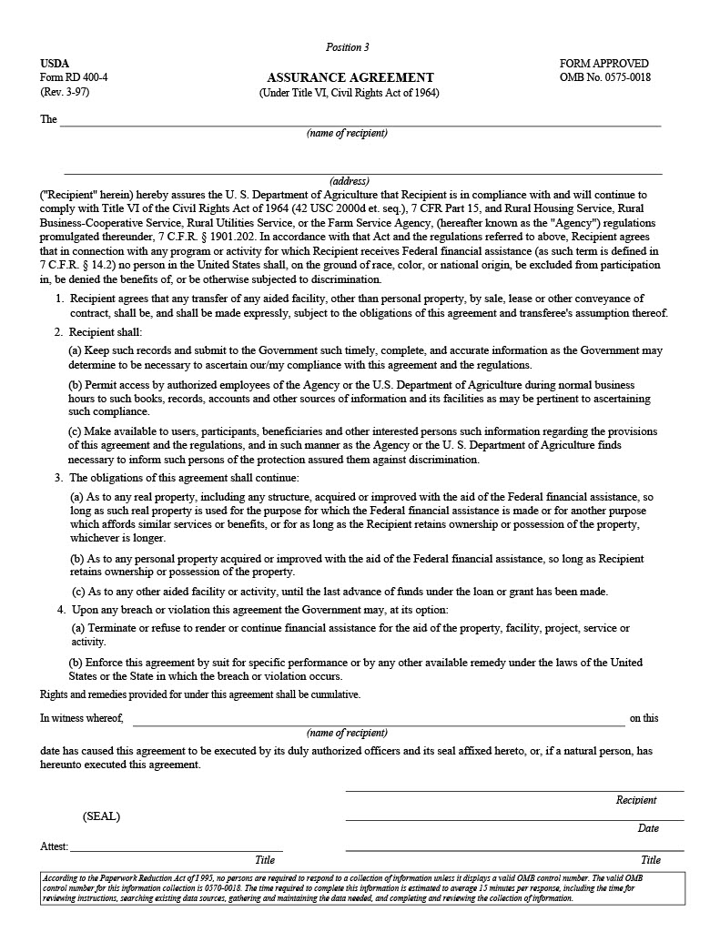
14. Assurance Agreement
RD Form 400-4
Commits your organization to carry out the provisions of Title VI of the Civil Rights Act of 1964
Include a signed copy of this form
Sample form in Application Handbook
Application Training

Slide 74
15. Fidelity Bond Coverage
Provide evidence of adequate fidelity bond coverage/ employee dishonesty insurance
^{*BP} Amount of the coverage should be at least equal to the amount of funds and property the organization will have at anytime
All staff who have authority to make purchases, execute contracts or sign checks should be covered
Read 2CFR200, deals with “Bonding and Insurance”
        Determine how it applies to you
        Review it with a lawyer and accountant
Complete form RD 440-24 “Position Fidelity Schedule Bond Declarations” to demonstrate compliance
Application Training

Slide 75
16. Evidence of Interest-Bearing Checking Account and Statement of Repayment of Interest
Submit a copy of the account agreement of your two-signature interest-bearing checking account
Include a signed statement saying that the organization will return, on a quarterly basis, any interest earned in excess of $500 per year
      If the grantee is a public body, interest in excess of $100 must be repaid.
Reference 1944.411(g) for a waiver if necessary
Application Training

Slide 76
17. Group/Participation Agreement (including Exhibit B-2)
Include a copy of your agreement (Samples in Handbook)
It must include Exhibit B-2, indicating the breakdown of construction (for new construction)
^{*BP} Each member of the group must read the document or have the document read to him/her, thoroughly understand it, and sign it
^{*BP} The enforcement of the membership agreement is key to the success of the program
For Rehab, include how hours will be tracked and how cost savings will be calculated
Application Training

Slide 77
18. Request for Obligation of Funds Form RD
Include this completed form, RD 1940-1
At item 45, on the back, have the authorized representative sign and date the form
See Application Handbook for sample
Application Training

Slide 78
19. Self-Help TA Grant Agreement
Grant Agreement is 1944-I Exhibit A
Sign, but don’t date copy of the agreement
Critical to read and understand agreement
Application Training

Slide 79
20. Certification Regarding Lobbying
Include a signed and dated RD 1940-Q, Exhibit A-1
See Handbook for form
Application Training

Slide 80
21. Statement of Compliance
Include a statement that the organization complies with the requirements of the appropriate 2 CFR 200, 400 & 415 (or 2CFR 200, 400 & 416 if a state or local government)
Know what you are agreeing to - 2 CFR 200 establishes uniform requirements for administration of grants
Authorized rep must sign and date it
Usually on agency letterhead
See sample letter in Application Handbook

Slide 81
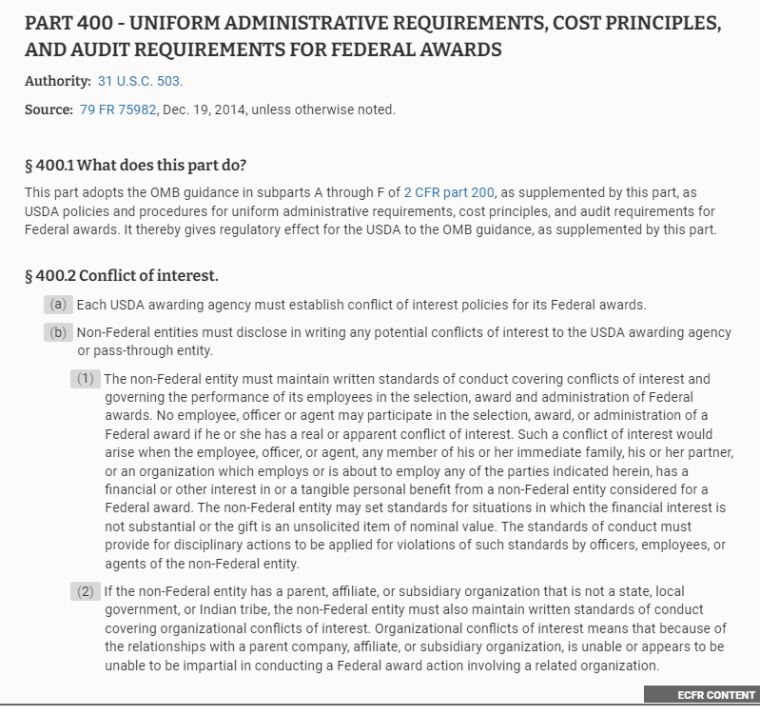
Part 400 says that USDA adopts 2 CFR 200 Parts A-F in accordance with grant regulations, so that the entire contents of the “Uniform Guidance” is what governs the grant management
This deals with having uniform administrative requirements, cost principles and audit requirements

Slide 82
Part 415 (or 416 for State/Local Govt) is specific to Dept of Agriculture (vs. all federal funding rules outlined in Uniform Guidance) for General Administrative Regulations
Part 415 then breaks down further into the subparts
A-Application for Federal Assistance
  Assuring competition in awarding (or in subawards)
B-Miscellaneous
  Audiovisuals/Publications will clearly identify USDA support
C-Intergovernmental Review – Dept of Agriculture
  Intention of fostering intergovernmental partnership between federal (interagency), state, and local programs
  Describes processing and comment periods
  Seeks simplification, efficiency

Slide 83
22. RD Area Managers’ Recommendation
Hold a section for this to be added later by RD
Application Training

Slide 84
23. T&MA Contractor’s Review and Recommendation
Hold a section for this to be added later by RD
Required under National Office Contract

Slide 85
24. National Office Review
Hold a section for this to be added later by RD
Application Training

Slide 86
25. Narrative Statement
The narrative statement should begin with a short paragraph that summarizes:
  Number of homes proposed
  Area to be served
  How much grant funds are being requested
  What time period is planned (usually 24 months but can be less)
NARRATIVE STATEMENT
Application Training

Slide 87
A description of the area to be served is needed
  ^{*BP} Include maps, population and housing statistics
  ^{*BP} Collect current data, include only what supports the need
  Sources: U.S. Census, State Housing Finance Authority, local government housing plan, area housing authorities, area Board of Realtors

Slide 88
Include housing conditions and why families need self-help housing
  ^{*BP} Analyze your data for comprehension. What does it show? Growth? Substandard housing? Income qualifications? Vacant rentals? Cost of housing?
  A need occurs when very low and low-income families want their own homes but adequate, affordable housing is not available to them!

Slide 89

^{*BP} Prove affordability!
  Estimate the cost of the self-help homes to the participants
  Give estimate of monthly principle, interest, taxes, insurance (PITI) payments and total debt ratios
  Compare this figure to the cost of homes in the area

Slide 90
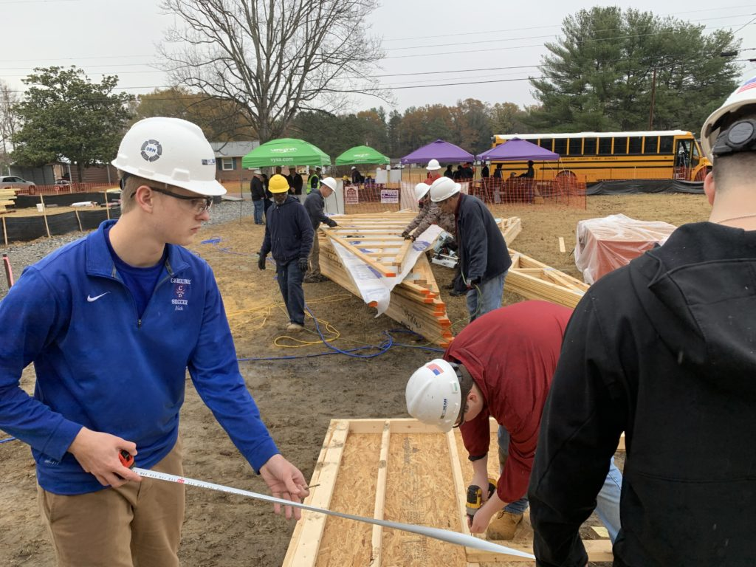
Provide evidence of low-income families willing to contribute labor
  This information was included earlier in the application, refer the reviewer to the correct section

Slide 91
Evidence of community support is required
  Include letters of support from local officials, individuals and community organizations
    ^{*BP} Develop and distribute brochures or fact sheets. Develop a relationship with the media. Know the benefits and drawbacks of the program. You will be asked!

Slide 92
  Benefits of community support:
    Help organization with leveraging additional dollars for incorporation and start up
    Provide needed political support from town and county governments
    Help create a positive self-help housing image

Slide 93

Sources of Community Support
    Those in need of improved housing
    Town and county governments
    Churches/religious groups
    Civic organizations
    Social service agencies
    Other nonprofits
    General public
    Business/industry sectors
    Media

Slide 94
For a Rehab Grant
  Include policies and procedures for the program
  Minimum / Maximum rehab cost per home
  Relocation policy, if any
Application Training

Slide 95
26. Current Financial Statements
A financial statement is required and should be prepared by an accountant (or by the sponsor’s accountant), and must be no more than 12 months old
Must be dated and signed by the Executive Director or Board President
Needs to show the specific nature of assets and liabilities
The most recent audit is also required
If using a sponsor, the same type of financial statement is required of them
Application Training

Slide 96
27. Outreach Plan for Very Low Income
A plan is required of how you propose to reach the very low income families
  It is important to reach families that are living in housing that is deteriorated, dilapidate, overcrowded or lacking in adequate plumbing
  VLI- Minimum of 40% of total families building in program should be VLI
  Develop a marketing strategy that will reach and recruit the families needed for your program
Application Training

Slide 97
28. HUD Fair Housing Marketing Plan 935.2B
Affirmative Fair Housing Marketing Plan
  HUD Form 935.2b, required
  Follow instructions
  Use accurate information
  Marketing plan designed to attract those “least likely to apply”
  Special outreach for those groups required
  Plan approved and monitored by Rural Development
  See Form in Application Handbook
Application Training

Slide 98
29. Determination of TA Grant Amount (for new construction)
Amount of grant depends on experience and capability of applicant
Must be justified based on the number of participants assisted
Three methods for determining grant (four including rehab)
Application Training

Slide 99
Method A: The Equivalent Value of Modest Housing (EVMH) x 15% x Number of Homes Proposed = Maximum TA Budget
$________ x .15 x _____ = $____________
Example:
EVMH = $200,000 x .15 = $30,000 (TA per home) x 12 homes = $360,000 (amount of grant request)
Application Training

Slide 100
RD Letter for EVMH
  Include a letter from RD identifying the equivalent value of comparable contractor-built 502 homes, less than 12 months
  Include total square feet and total living area
  Should include the actual or projected cost of an acceptable site and site development

Slide 101
Method B: EVMH – Average mortgage - $1,000 = Maximum TA cost per house (This can only be used by experienced grantees or those who know what their mortgages will be.)
Example: $150,000-$120,000-$1,000=$29,000
Method C: Amount established by the State Director to accomplish a particular goal
^{*BP} Use worksheet in Application Handbook to calculate maximum per unit TA amount
Application Training

Slide 102
Determination of TA Grant Amount
(for rehab)
Rehab is determined by a negotiated amount
RD made a goal of having the TA cost be less than or equal to the cost savings of the participants
  There are 3 ways to determine cost savings
Include examples of all three
See Application Handbook for examples
Application Training

Slide 103
Contractor Cost Savings
  Compares contractor bids or estimating software costs to participant work
Appraised Value
  Compares the improved cost of the home to the appraised value
Hourly Rate of Labor Contribution
  Establishes an hourly rate for the job and multiplies the number of hours the participant will work
Application Training

Slide 104
Method of TA Cost Calculation
  Include the calculation of how the total grant amount was calculated
  Indicate which allowable method was used
  See sample calculations in Handbook

Slide 105
30. Intergovernmental Review Submittal
This section needs to contain proof that the application was submitted to the appropriate state official for review
Not all states have this requirement
Google SPOC (State Single Point of Contact) list for state contacts (list for 2020 in Application Handbook)
If required, send the SF-424 and SF-424A along with a narrative – the whole application is not needed
Application Training

Slide 106
31. Civil Rights Impact Analysis Certification, Form RD 2006-38
Form RD 2006-38 2006-P, 2006.754(b)
Rural Development will complete this form
Hold a spot for this in the application
Application Training

Slide 107
32. Compliance Review (pre-award)
Hold a section for this to be added later by RD
RD may request that the grantee complete Section 1, Statistical Information
Demographic information for interested applicants and participants should be kept to provide to RD
Sample form in Application Handbook
Application Training

Slide 108
33. OGC Review (if necessary)
If necessary, RD may send organizational documents for OGC for their review
Hold a section for this to be added later by RD
Application Training

Slide 109
34. Previous Experience
RD requires that the organization have the financial, legal, and administrative capacity to carry out the responsibilities of the grant.
A narrative statement about the organization’s previous experience and capacity to carry out the Grant Agreement is required. It may include:
  Summaries of previous and current RD funded programs
  Summaries of previous and current other programs
  Description of current capabilities (management, admin, staffing, financial, etc.)
  Experience or capability of relevant staff and Board members
  Objectives of the organization
    One must be “Production of affordable housing”
Application Training

Slide 110
35. Organizational Papers
A copy of the provisions of state law under which the corporation was organized, or an accurate reference to the provision(s) organized under
Articles of Incorporation (certified, signed and dated)
Bylaws (certified, signed and dated)
Board list (5+, names, addresses, titles)
  For smaller orgs, less than 5 staff members, boards of 3 OK
Certificate of Incorporation
501(c)(3) certificate
Evidence of Good Standing from Secretary of State
If another organization is a member of your organization – its name, address and principal business
If not formally organized, submit proposed documents
Application Training

Slide 111

Putting the Application Together

Slide 112
Use the Rural Development Checklist for order and format
Include a Table of Contents and tab the sections
^{*BP} Check every page for completeness, signatures and dates
^{*BP} Send the application to your T&MA Contractor first for a draft review
Submit electronically, we will send it to the designated Rural Development office
^{*BP} See Application Handbook for links to forms
Application Training

Slide 113

F. Developing a Self-Help Housing Program / Know the Program

Slide 114
Developing a Self-Help
Housing Program
^{*BP} Be realistic. Go into the process with your eyes open
^{*BP} Know that this is a lengthy process
^{*BP} Recognize the commitment of staff and board time
^{*BP} Be aware that housing is a political animal and requires community support
^{*BP} Don’t expect overnight success
^{*BP} Set realistic expectations
Application Training

Slide 115
^{*BP} Be committed and serious about developing a self-help program
  Housing will need to be a priority for you
  Accountabilities are high
  Strive to meet time frames set
  Recognize fiscal responsibilities and advantages of self-help housing for your organization

Slide 116
^{*BP} Other ingredients to develop a successful self-help housing program include:
  Obtain all applicable housing regulations
  Subscribe to or request housing publications such as HAC News, NRHC Legislative Update, RD’s GovDelivery
  Have access to federal and state registers
  Join the mailing list of your state housing finance agency

Slide 117
  Build a housing resource library
  Join your state housing coalitions
  Join local and state chapters of housing groups
  Know your local housing market
  Provide proper orientations and training of the program for board and staff
  Visit another self-help housing organization

Slide 118
Program Decisions
^{*BP} Determine the number of homes to build
  Be very realistic!
  Consider availability of suitable building sites
  Consider need for housing in your selected area
  Consider number of persons eligible to participate
Application Training

Slide 119
^{*BP} Determine ways in which to reach very-low income
  Know your target market
  This will help you determine methods of outreach, time needed, manpower necessary and cost
  There is more on recruitment later in the training
Application Training

Slide 120
^{*BP} Determine staff needs and size
  Should correlate with number of homes to be built
  Traditionally for a small Self-Help organization, staff consists of 3-4 positions. Areas of responsibility include:
    Executive Director/Project Director
    Group Coordinator/Loan Packager
    Secretary/Bookkeeper
    Construction Supervisor
Application Training

Slide 121
Know the Program
^{*BP} RD instructions provide policy, guidance, and basis for the program operations. Be familiar with them.
Use the internet as needed to look up regulations and information, https://www.rd.usda.gov/page/regulations-and-guidance
^{*BP} Know 1944-I!
Please refer to the Application Handbook for a list of other regulations to become familiar with
Application Training

Slide 122
^{*BP} You can print out the 1944-I and HB-1 3550 but these instructions change often, so we encourage the use of the internet
Application Training

Slide 123

F. Grant Closing and Drawdowns

Slide 124
Request for Advance or Reimbursement, Form SF-270
  Form completed monthly and submitted to RD along with a working budget
  Used to notify RD of the grant funds used during the previous month, the unspent funds on hand, and the projected need for the next month
  Written justification should be forwarded if amount exceeds the projected need for the next 30 days
  Must be in the correct RD office 15 days prior to the beginning of the month
  Payment is usually handled electronically, sign paperwork to make this happen
Application Training

Slide 125
Rural Development can establish an electronic transfer for the funds
  They will need the routing and account numbers
The first grant draw can be for the month in which the grant was closed, the following month and can include funds for tool and equipment purchases
Application Training

Slide 126

Fair Housing

Slide 127
Introduction
The right to fair housing is set by law
Training in this area is crucial
Affects every staff person in the self-help program
Right to fair housing enforced by formal complaint process, litigation, testing and monitoring
Lack of knowledge is not an acceptable excuse
Application Training

Slide 128
The Fair Housing Act
Prohibits discrimination because of:
  Race or color
  National origin
  Religion
  Sex
  Familial status
  Handicap / Disability
Covers most housing - definitely housing that is federally financed
Law effects sale and mortgage
Application Training

Slide 129
Other Applicable Laws
Know that housing laws exist and must be enforced. Such laws include:
  Title VI of the Civil Rights Act of 1964
  Section 504 of the Rehabilitation Act of 1973
  Age Discrimination Act of 1975
  Title II of the Americans with Disabilities Act
  Section 109 of the Housing and Community Development Act of 1974
  Title VIII, Title VI
  Record keeping requirements: racial & ethnic data ((1901.202(g))
Helpful Websites: HUD: http://www.hud.gov
USDA: http://www.rurdev.usda.gov

Slide 130
Fair Housing Marketing
Affirmative Far Housing Marketing Plan
  HUD Form 935.2b, required for self-help program
  Follow instructions
  Use accurate information
  Marketing plan designed to attract those “least likely to apply”
  Special outreach for those groups required
  Plan approved and monitored by Rural Development
Application Training

Slide 131
Fair Housing Advertising
To comply with Fair Housing Act, the following requirements must be met:
  No discriminatory or limiting words or phrases allowed
  No selective use of media and models which can lead to discriminatory results
  Use fair housing policies and practices
    All advertising for real estate must contain the equal housing opportunity logotype, statement or slogan
For further details, see Guide
Application Training

Slide 132

Equal Housing Opportunity Logotype -
Equal Housing Opportunity Slogan
  “Equal Housing Opportunity”
Equal Housing Opportunity Statement
  “We are pledged to the letter and spirit of U.S. policy for the achievement of equal housing opportunity throughout the Nation. We encourage and support affirmative fair housing advertising and marketing program in which there are no barriers to obtaining housing because of race, color, religion, sex, handicap, familial status, or national origin.”
Application Training

Slide 133
Participant Selection and the Membership Agreement
^{*BP} Two ways to ensure that all fair housing laws are being followed
  Consistency
  Documentation
A person with a disability cannot be denied the right to participate in the Mutual Self-Help Housing Program
RD and grantees are to make reasonable accommodations which allow someone with a disability to participate
Application Training

Slide 134
“Participating family” definition allows substitute labor with prior approval by State Director
In reward or corrective action, participants should be treated equally
^{*BP} Follow rules in Membership Agreement, always
Application Training

Slide 135
Identifying and Solving Potential Fair Housing Problems
Contact Rural Development or HUD immediately
Use mediation and all available resources
Understand the complaint process
Complaints must be filed within one year
Either HUD or RD may investigate
Try to reach a conciliation agreement
If agreement breached, further legal action taken

Slide 136
Additional Resources
Various fair housing training materials exist
HUD’s Fair Housing Information Clearinghouse has brochures, videos, PSAs, posters
Rural Development can also provide materials and training
Application Training

Slide 137
Stay in Compliance
^{*BP} Review the Affirmative Fair Housing Marketing Plan every quarter to ensure compliance
Enforce Fair Housing Advertising requirements
Display Fair Housing Posters as required by RD
Questions should be addressed to State Civil Right’s Coordinator
Application Training

Slide 138
The End

